Slide 1

Indigenous Victims of Crime

Slide 2
Why is it important to study victimization of this group?
“The rate of violent victimization among Indigenous people was more than double that of non-Indigenous people (163 incidents per 1,000 people vs. 74 incidents per 1,000 people). - Juristat

Slide 3
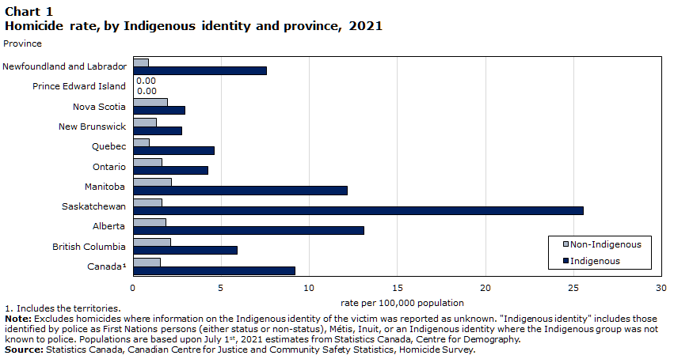

Slide 4
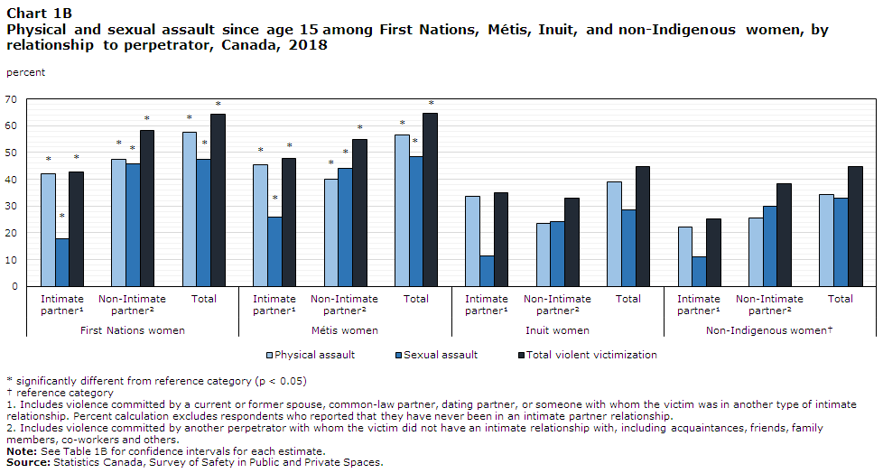

Slide 5
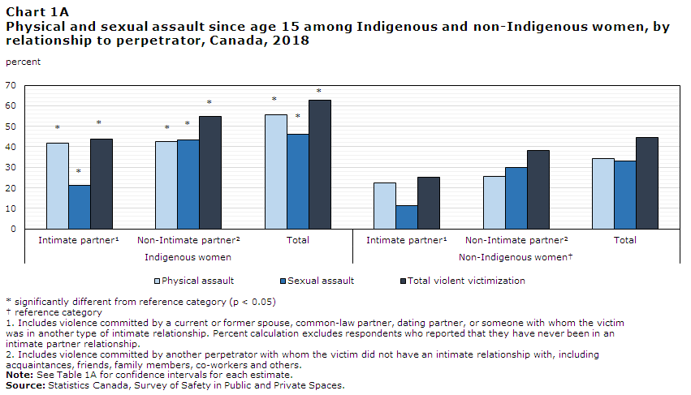

Slide 6
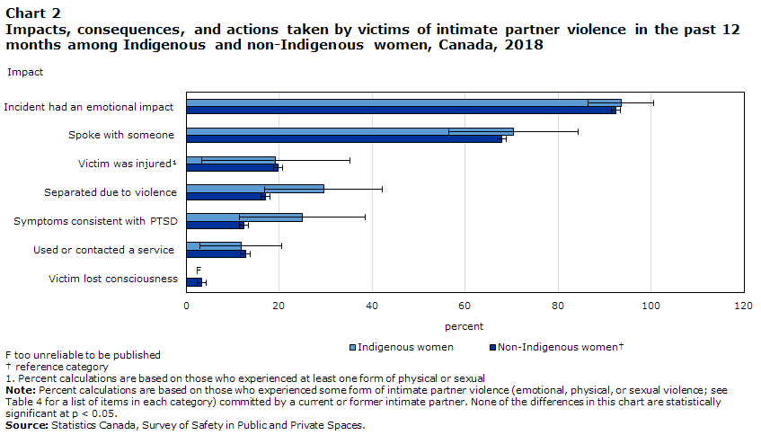

Slide 7
Over-representation among victims of human trafficking
Indigenous girls are drastically overrepresented in sexual exploitation. They comprise between 50 and 90% of the cases in Western Canadian cities, despite representing from 2 to 5% of the population in these regions (Louie 2022).

Slide 8
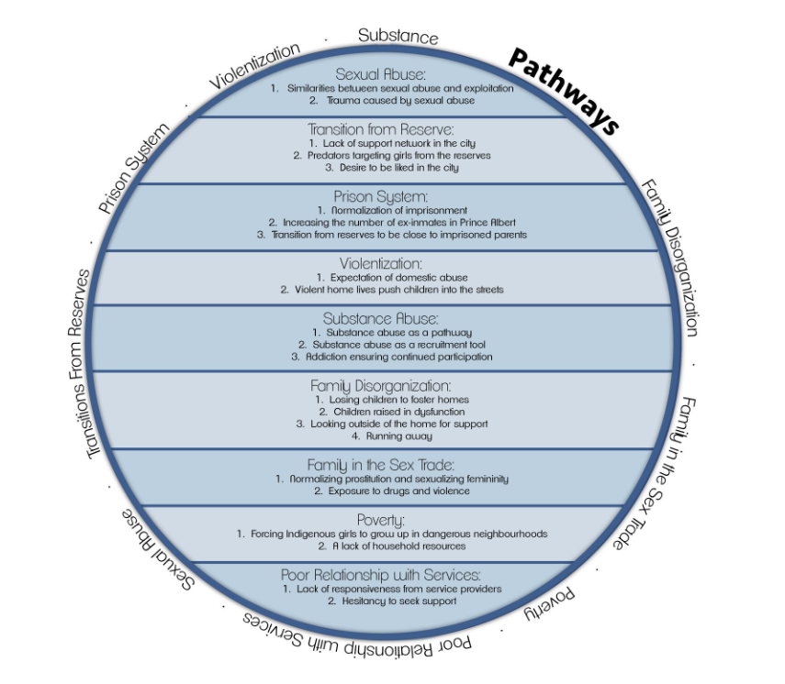
Q1: Which Life Experiences Create an Increased Threat of Sexual Exploitation for Indigenous Girls? - Louie (2022)

Slide 9
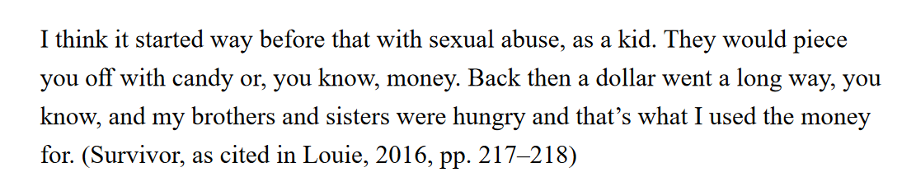

Slide 10
Q 2: How Are Indigenous Girls Recruited Into the Sex Trade?
Recruitment by other females
boyfriends,
gangs,
meeting basic needs,
social media,
substance abuse,
family recruitment,
reserve recruitment.

Slide 11
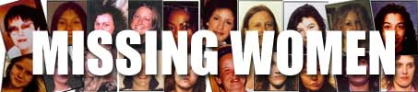
Missing and Murdered Women Indigenous Women and Girls
Based on RCMP data, an estimated 1200 Indigenous women and girls were either murdered or reported missing between 1980 and 2012. 1,017 were homicide victims and the remaining 164 are missing. Of course, as we know, figures for missing individuals only represent those women and girls who have been reported.
According to Stats Can, in 2006 there were 600,700 Indigenous women in Canada.
This means that approximately 2% of this segment of the population was murdered or went missing over a 32 year period. Many of these cases remain unsolved.

Slide 12
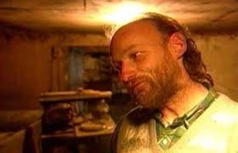
The Pickton case
BC Serial killer Willie Pickton is alleged to be responsible for the murders of at least 60 women. Although remains of 22 victims were found on his farm, he was convicted for 6 of these murders. Of the 22 victims, it is believed that half were Indigenous women. Indigenous women are also disproportionately represented among the 60 alleged victims.
After Pickton’s conviction, the BC government convened the Oppal Commission (the Missing Women’s inquiry) to look at issues related to the investigation of this case.

Slide 13
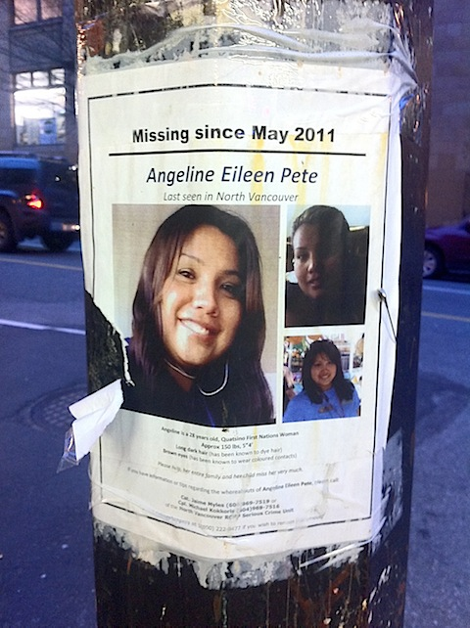
Some Pickton factors – various sources
Inexperienced investigators
Understaffed ‘Missing Persons’ unit
Linkage blindness
Systemic biases – “these women are transient, they’re probably in another city”; not believing witnesses, reports

Slide 14
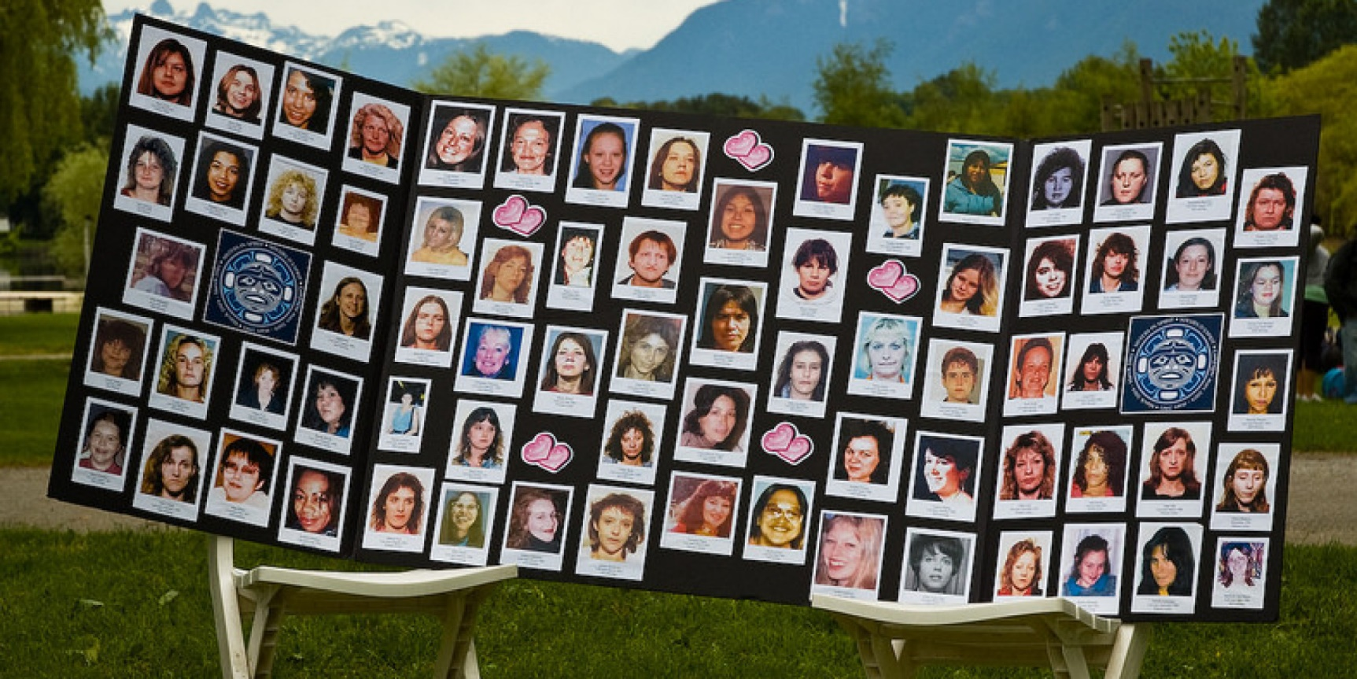
Highway of Tears
is a stretch of northern British
Columbia which is associated
with a string of unsolved
homicides and missing women
cases (Highways 16, 97 or 5).
Police estimate that the number of
victims is 18; Indigenous groups put the figure at 40+.
The earliest case goes back to the late 1960s (1969); other cases are much more recent (2011). Of the 18 officially recognized victims, 13 are teenagers and ten are women of Indigenous descent.

Slide 15
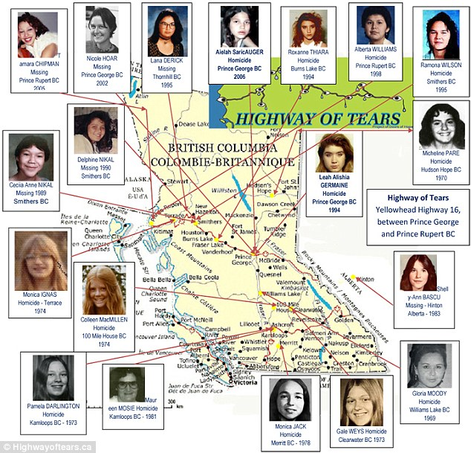

Slide 16
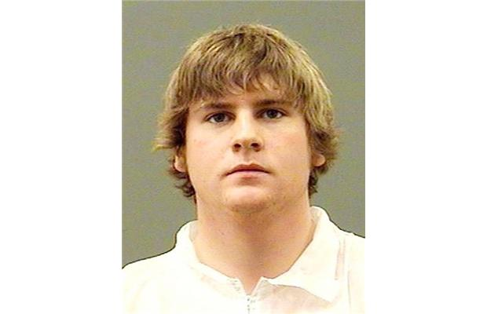
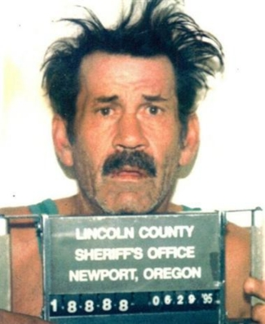
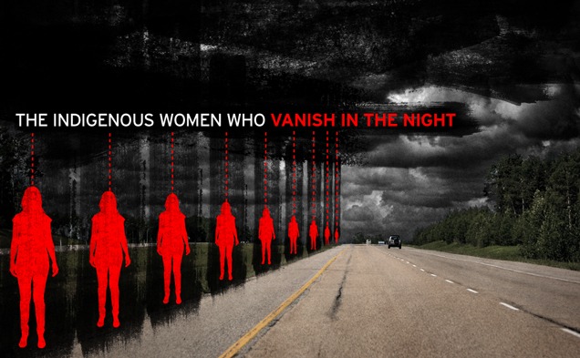
Cody Legebokoff – was convicted of the murder of 4 women near the Highway of Tears; however, police could find no evidence linking Legebokoff (23) to the 18 cases they were investigating.
In 2012, through DNA recovered from victim Colleen MacMillen, RCMP identified a Texas man and itinerate worker, Bobby Jack Fowler, as a prime suspect in MacMillen’s death and the deaths of 2 other Highways of Tears victims. Fowler died in prison in 2006.
In 2015 the Trudeau government
announced they would convene a
Public Inquiry into Murdered and
Missing Aboriginal Women and Girls.

Slide 17

*all done!*

